Slide 1





Vienna
14 June 2026
Jérôme Segal, Sorbonne University - jerome-segal.eu / jerome.segal@gmail.com

Slide 2
I – Observations: food, trends, movements and “veganwashing”
II – History : Amirim, Dimona, Gary Yourofsky and Tal Gilboa
III – Anything to do with Judaism? Rather Jewishness?
IV –Trend, social movement… and parallel dehumanization

Slide 3

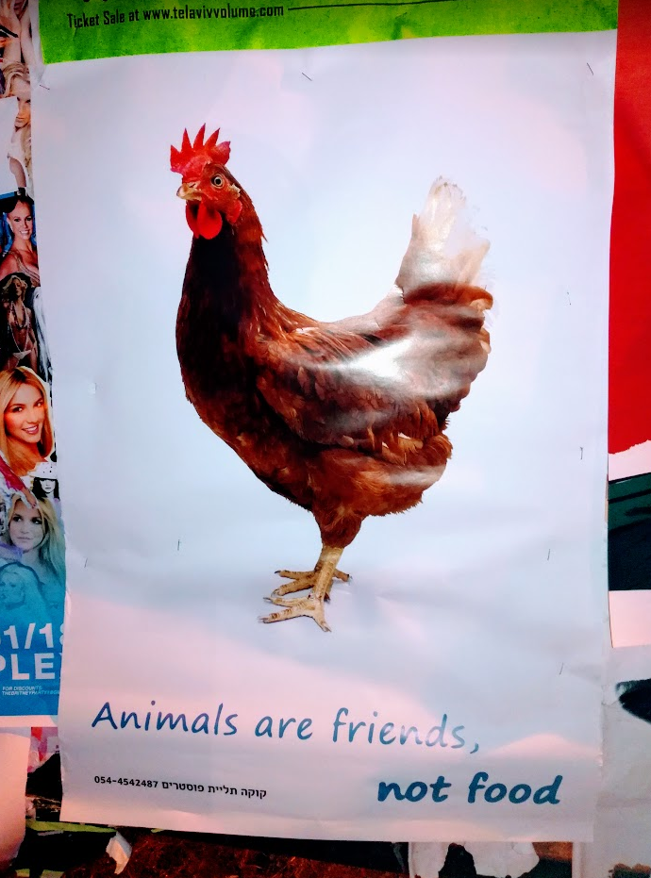
I - Observations
3-5% of the Israeli population is vegan
vs.
“Veganism sells!”
Education & politics

Slide 4
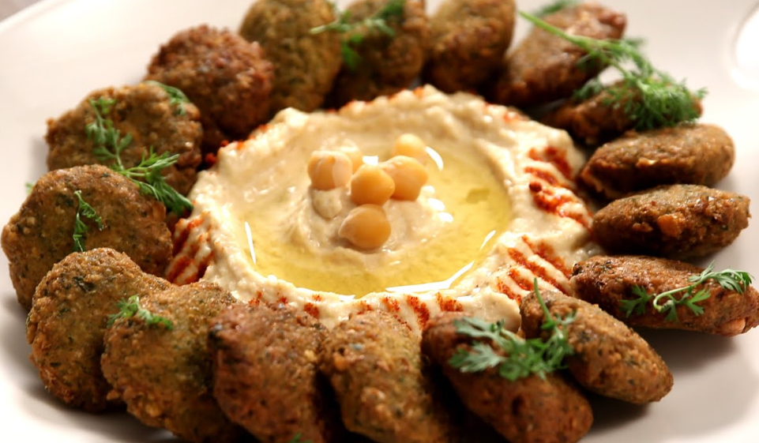

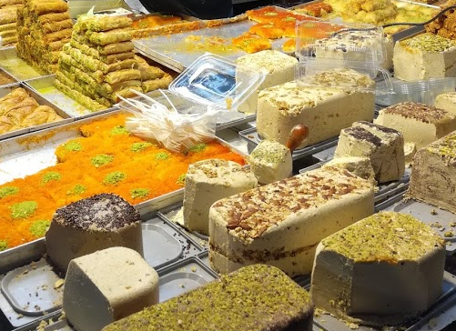
The Israeli food

Slide 5



Slide 6


Slide 7
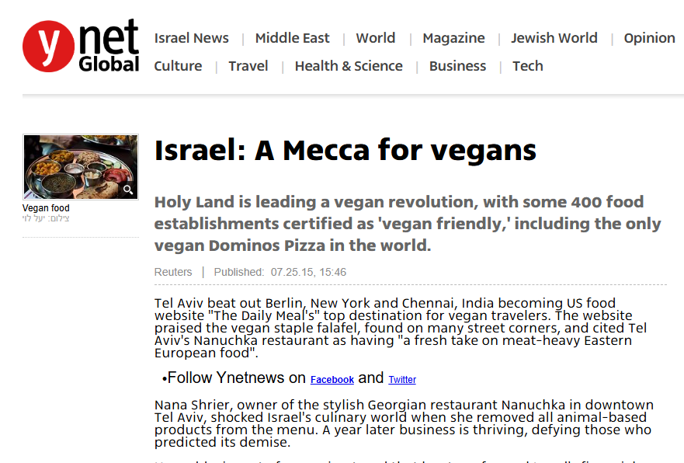

Slide 8
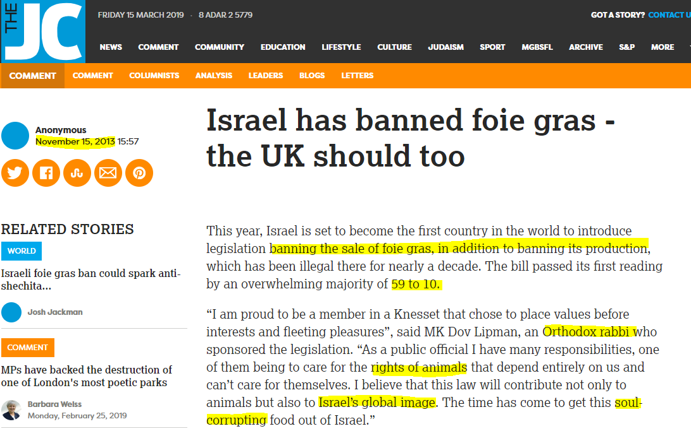
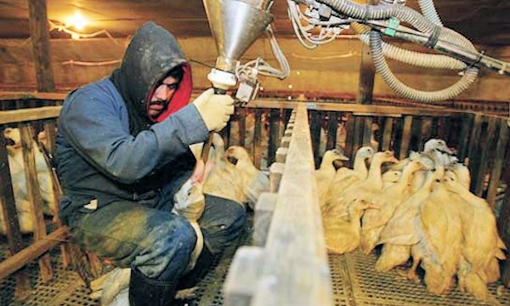
The 2013 ban on “foie gras”

Slide 9
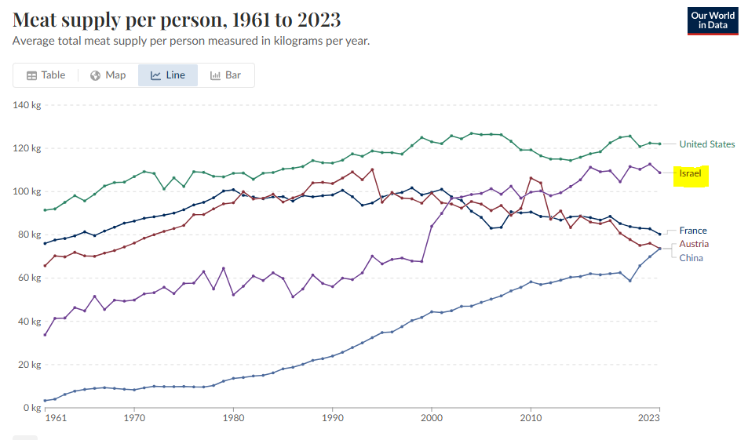
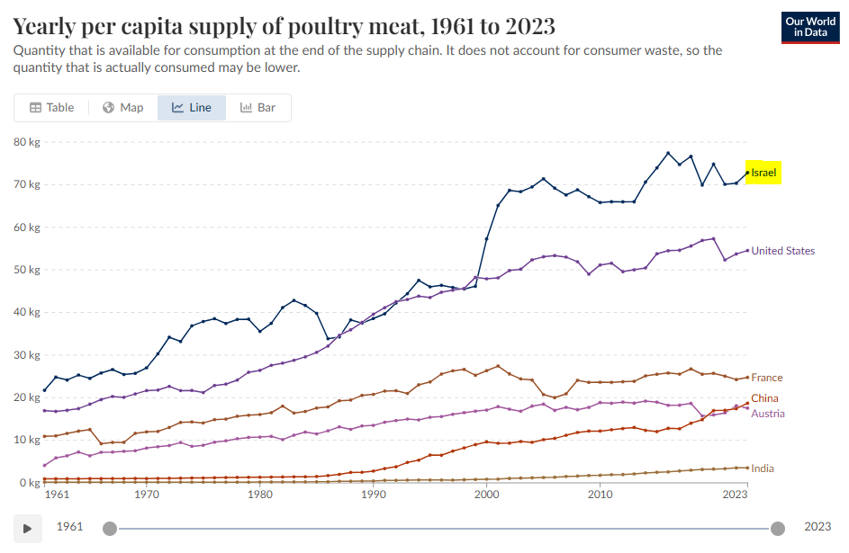
But …

Slide 10
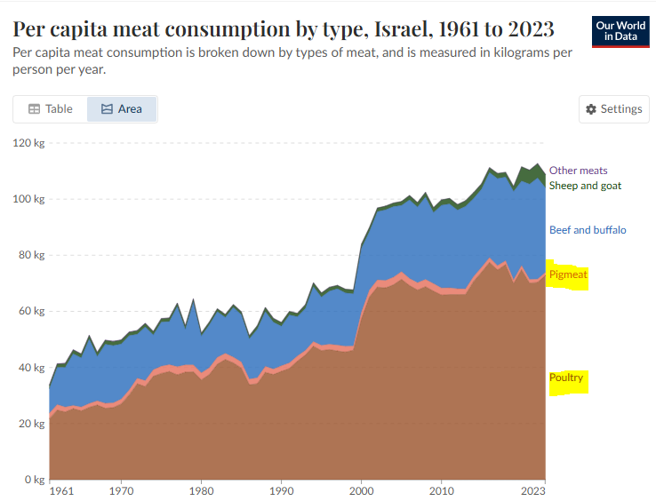
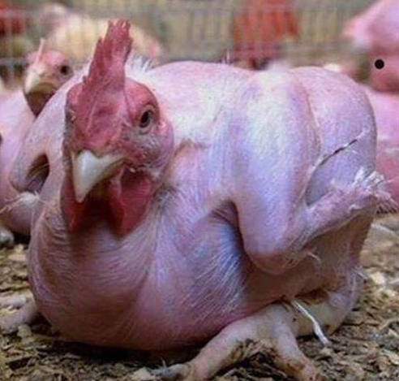
Featherless chicken, created by Scientists at the genetics faculty at the Rehovot Agronomy Institute

Slide 11
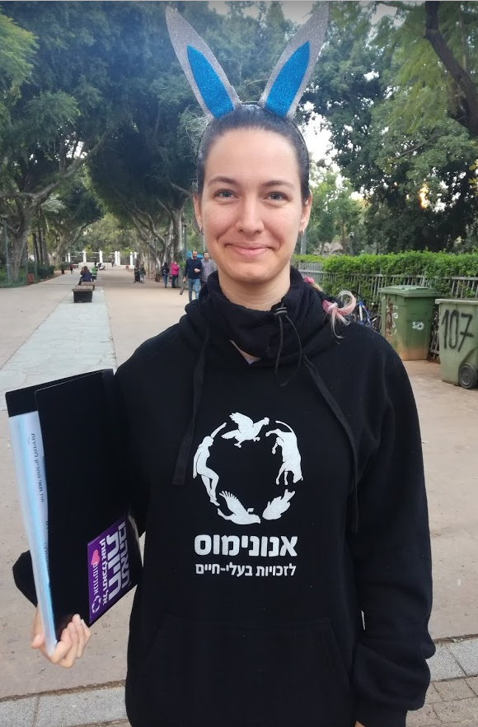
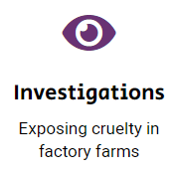
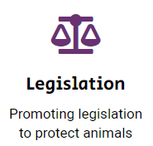



Movements
“Anonymous for Animal Rights” (since 1994)
=> (Oct. 2018) “Animals”
Adi, Rabin Square , Tel Aviv, 3 January 2018

Slide 12
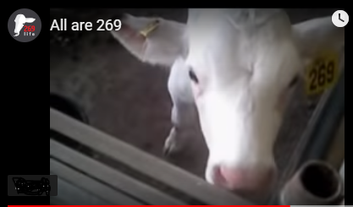

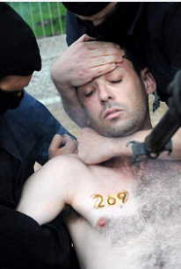
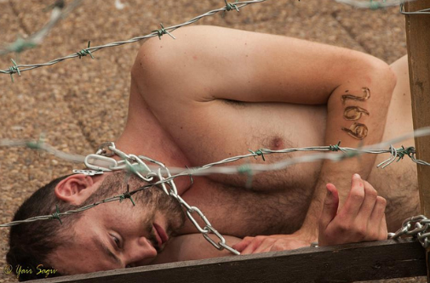
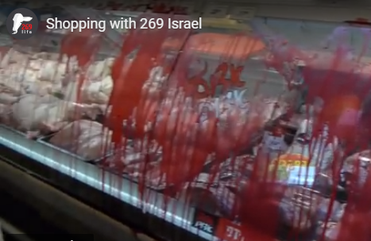
The activists got branded with a hot steel brand, in the same way farm animals are branded in farms all over the world.
269 Life (since Oct. 2012, Sasha Boojor)
“Direct actions”

Slide 13


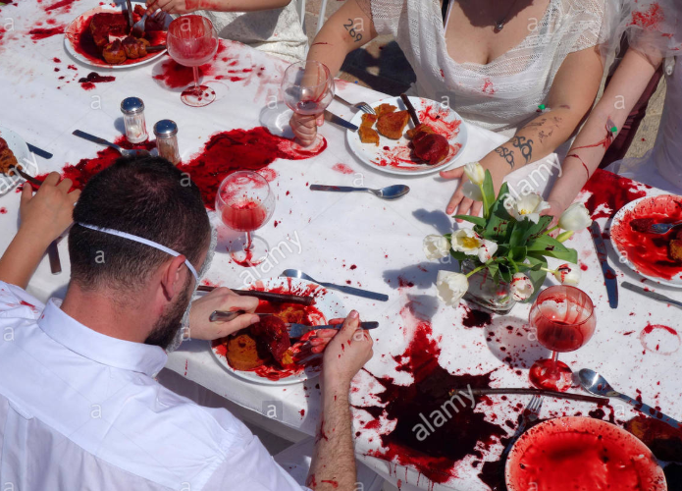
“If there is no struggle, there is no progress. Those who profess to favor freedom, and yet deprecate agitation, are people who want rain without thunder and lightning. They want the ocean without the roar of its many waters. Power concedes nothing without a demand. It never did and it never will.”
(Frederick Douglass, slavery abolitionist, 1818-1895)
And the grill action on the Independence Day…

Slide 14
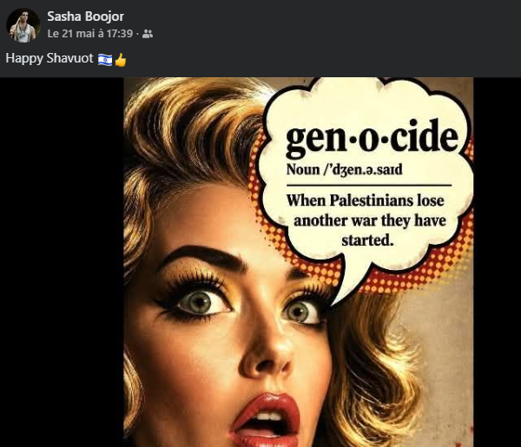
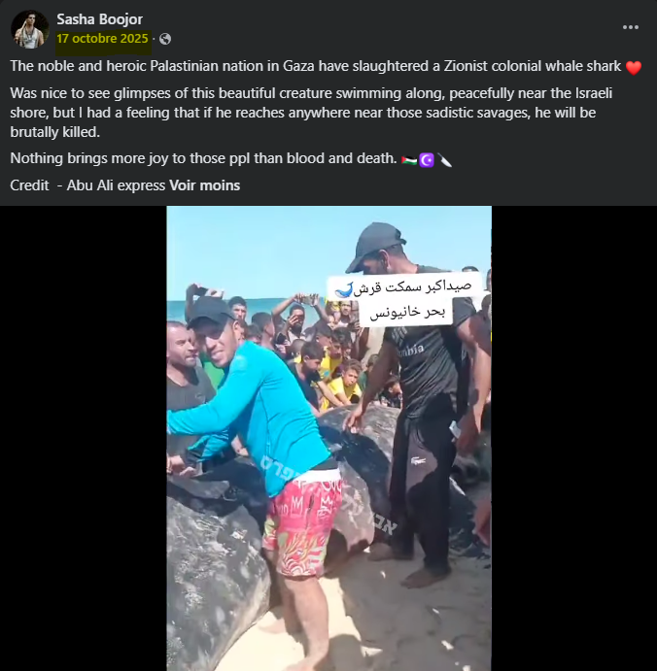


Sasha Boojor in 2026

Slide 15


Veganwashing?
Greenwashing

Slide 16

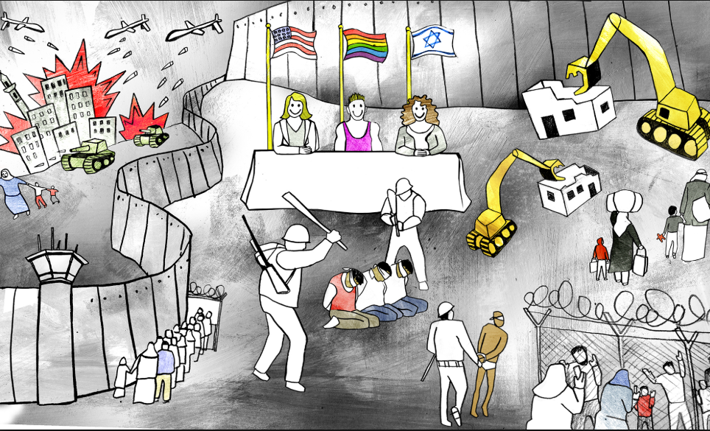
Pinkwashing

Slide 17

ESC 2026 in Vienna
Queer activists have accused the European Broadcasting Union (EBU) of “pinkwashing” Israel ahead of the Eurovision Song Contest final on Saturday.⁠
⁠Thursday evening’s show included a pre-recorded message about the LGBTQ community, often seen as a key audience for the event, detailing the history of the contest and its openness to the community.⁠
However, many LGBTQ activists have been among those vocally opposing Israel's involvement and say the country and the EBU, which runs the event, are engaged in laundering Israel’s reputation or “pinkwashing”.⁠
Omar Khatib, a queer Palestinian writer and organiser from Jerusalem, told Middle East Eye that people had a clear choice to make.⁠
“Either you are against genocide and against the mass killing of Palestinians, or you are willing to normalise and coexist with it,” he said.⁠
“Eurovision has become another test of our collective humanity in this sense - the question is no longer whether culture and politics can be separated, but whether people are willing to continue celebrating spectacle while an ongoing genocide is being livestreamed to the world.”⁠
⁠Khatib added that Eurovision's claims of political neutrality also rang hollow, saying it had become a stage where “liberalism, nationalism and colonialism intersect under the language of diversity and inclusion”.⁠
⁠As a result of the anger over Israel's inclusion, many LGBTQ people will break with what may have been the habit of a lifetime and refuse to watch Saturday’s final.⁠

Slide 18
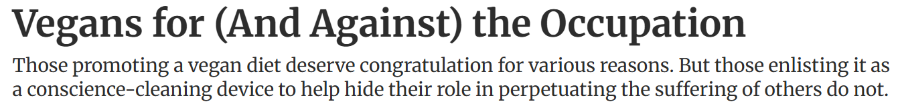
« Veganwashing »
Haaretz 2013 (Aeyal Gross)
“Eyal Megged has recently (“Back Bibi on animal rights – and help Israel to boot,” Haaretz, October 21) called on Prime Minister Benjamin Netanyahu to champion animal rights as a default option. “[W]hat’s there to stop Netanyahu from being a real reformer in animal welfare? After all, peace with the Arabs isn’t going to happen, so why don’t Livni and Netanyahu harness their futile efforts on talks with the Palestinians to a goal that would truly make us a light unto the nations? Why not make ourselves the champions of progress on an issue that enlightened people the world over take seriously?” Netanyahu apparently likes the idea: This week he announced his support for the Meatless Monday project and noted that he and his family are very sensitive to the issue of cruelty to animals.
(…) In Tel Aviv today, it is far easier to find food whose preparation has not involved the exploitation of animals than to find food whose production has not entailed the oppression and uprooting of other human beings.

Slide 19
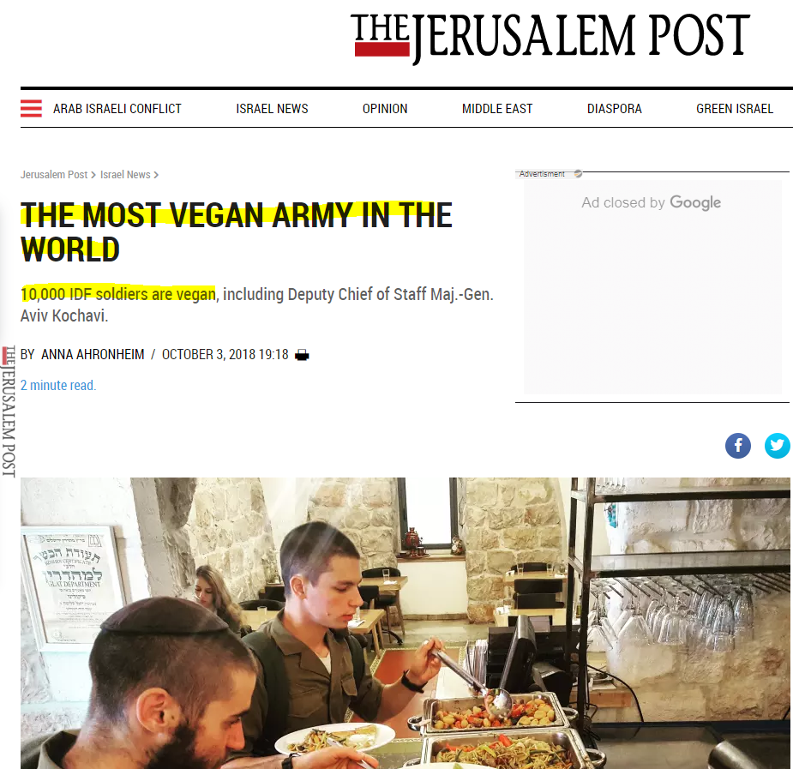

The myth of “the most ethical army in the world”, now extended!

Slide 20

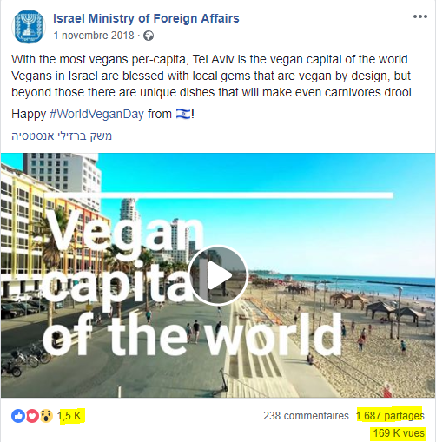
Birthright Israel trips are free 10-day educational tours for young Jewish adults. To participate, you must be 18 to 26 years old, have graduated high school, and have at least one Jewish birth parent or a recognized conversion.

Slide 21
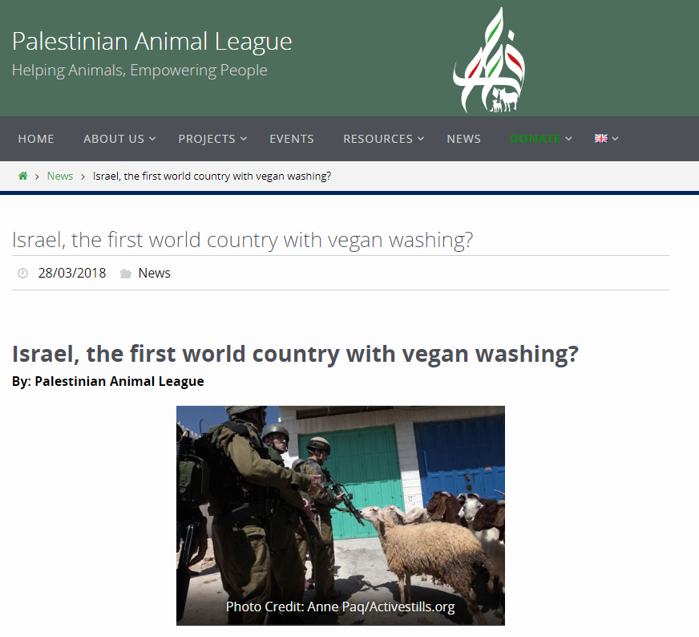
Then Palestinians also used the term “Veganwashing”
Palestinians claim that
so-called “typical” Israeli food is culturally appropriated from Palestinian cuisine. Israelis love schnitzel.
traditional Palestinian food was almost purely vegan. After the Nakba, the UNRWA introduced corned beef and increased meat consumption.

Slide 22
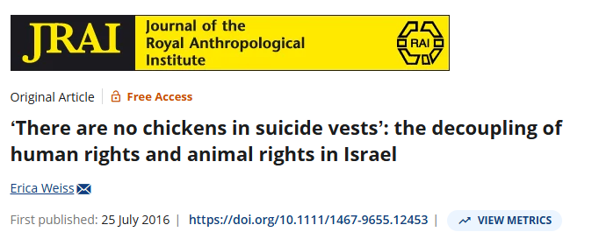
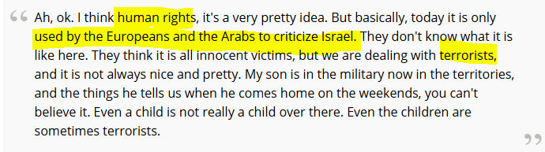

Slide 23
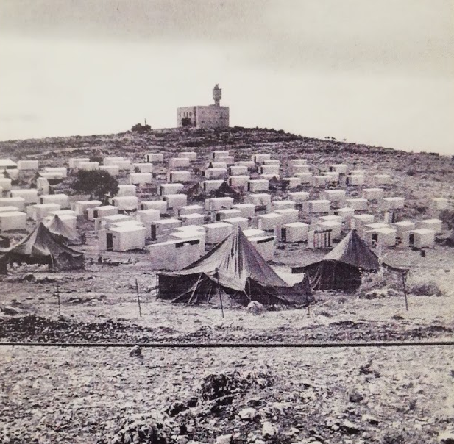
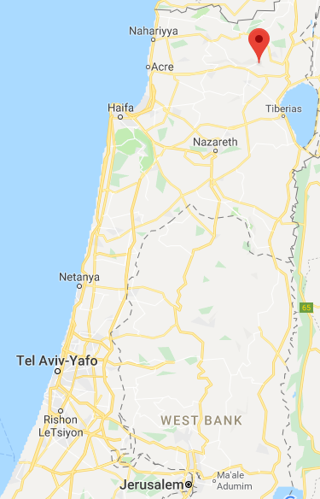
II - History
The village of Amirim in the 1950s
Early 1950s, settlers camps with Yemenites, Tunisians, Moroccans. They left (too cold).
11 people from the Israeli Vegetarian association decided in the mid 1950s to build a vegetarian village…

Slide 24
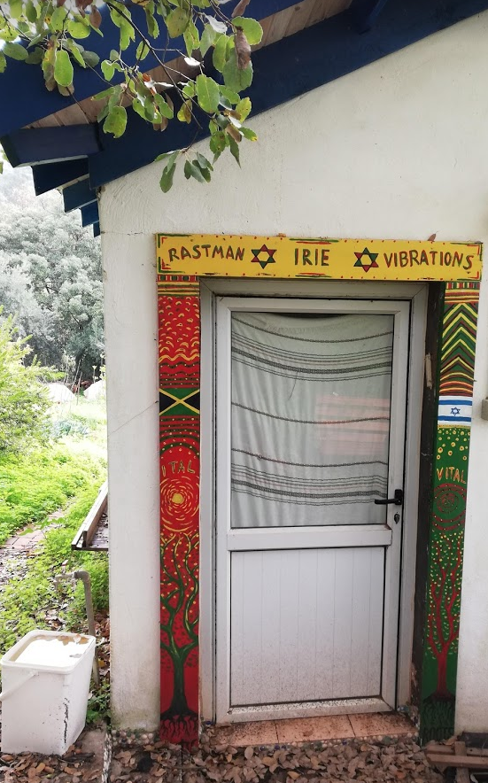
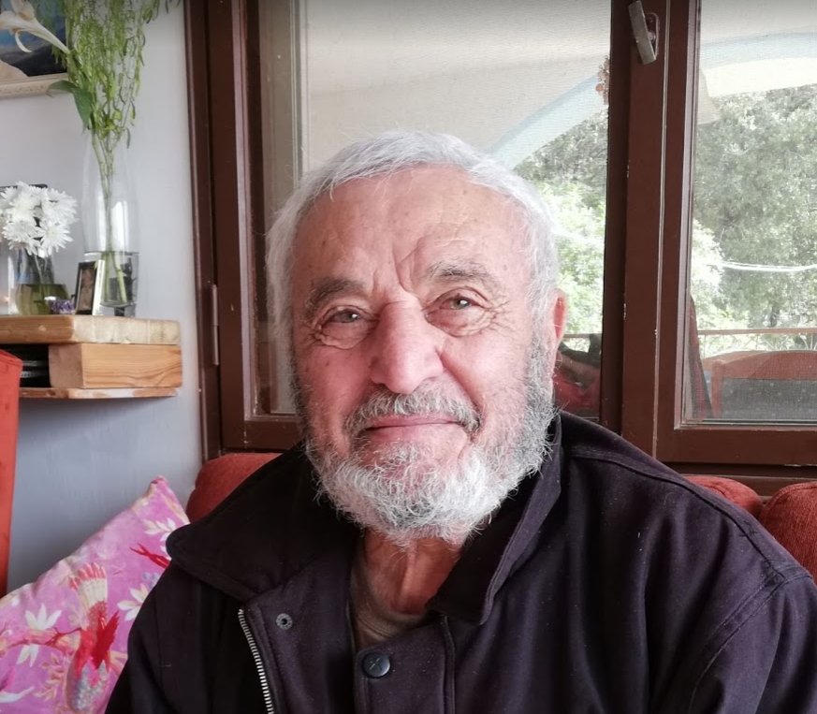
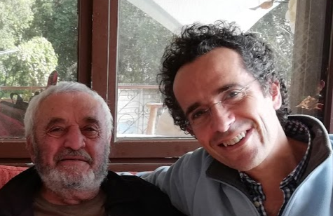
Yehuda Karmeli, born 1935, the last of the 11 founders
1950 vegetarian
1970, hippies
“No meat, no fish” policy
Nowadays, “organic food”, spas, no more strictly vegetarian

Slide 25
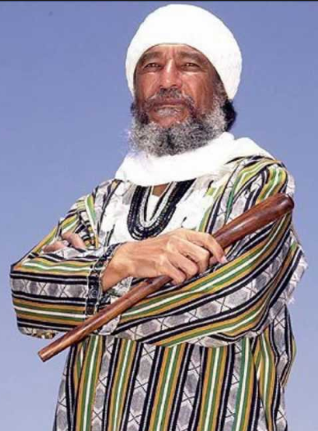
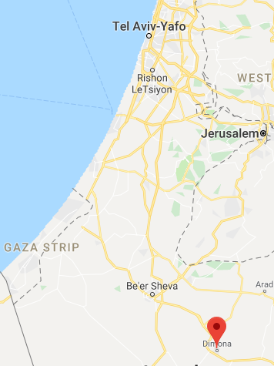
Dimona in the 1970s
Ben Carter
=> Ben Ammi Ben-Israel (1933-2014)
Metallurgist in the mid-1960s in Chicago’s southside ghetto
1961, Black Israelite group (one of the 12 tribes)
1966, Vision, Angel Gabriel, Liberia in 1967.
Passover 1968, goat accident, “African Hebrew Israelites of Jerusalem”
=> Israel 1970 as vegans!

Slide 26
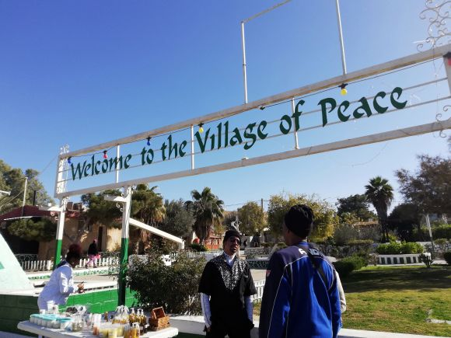
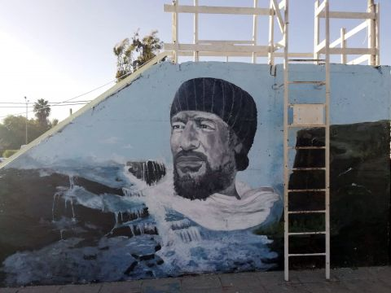
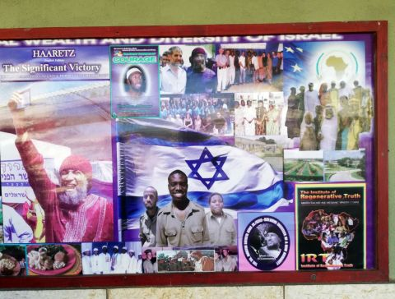
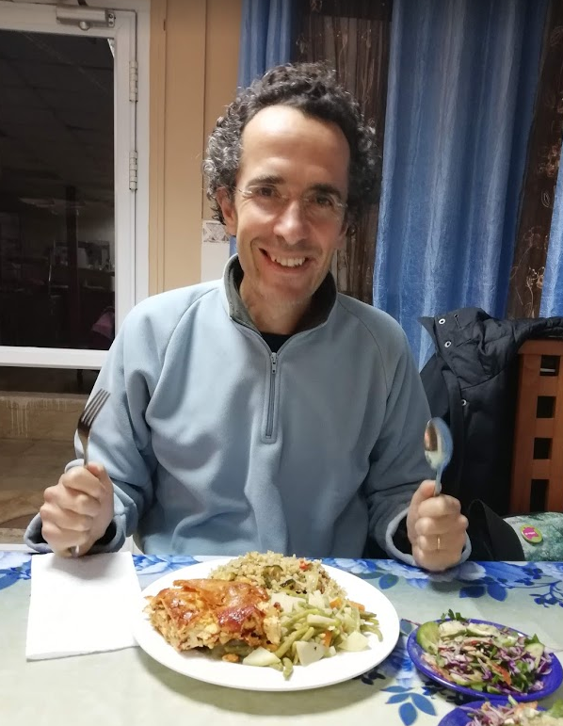
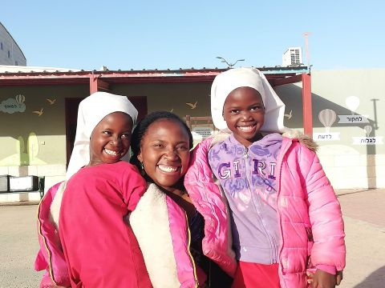
Sport
3x45’
Fasting
Contraception
January 2019

Slide 27
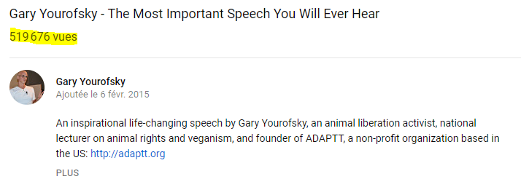

Gary Yourofsky
1999: he freed minks held captive for slaughter on a fur farm in Canada. He is now banned from entering Britain and Canada.
Arrested 13 times and imprisoned for 77 days in a maximum-security lockup
2,388 lectures to more than 60,000 people at 178 schools…
AND “I have clearly stated, that I hate all humans. (…) I now firmly believe that n°1 impediment to the progression of animal rights, is human rights.”
“The Palestinians are the most psychotic group of people on the planet.”
Also a controversial person. Vegan, former activist.
2014: won the Israeli version of the reality show Big Brother (HaAh HaGadol)
Advertise for vegetable sausages for a processed meat company (Zoglobek)
During 2019, Gilboa joined the Likud party and was appointed by prime minister Netanyahu as advisor on animal rights issues.

Slide 28

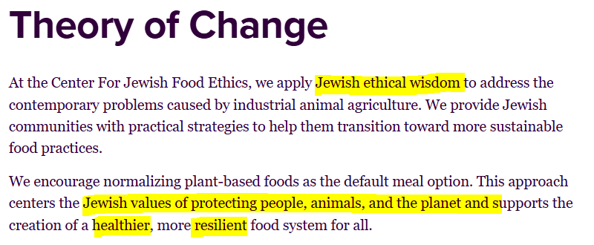

III – Anything to do with Judaism? Rather Jewishness?
Genesis 1:29
Then God said, “I give you every seed-bearing plant on the face of the whole earth and every tree that has fruit with seed in it.”
jewishveg.org => jewishfoodethics.org

Slide 29
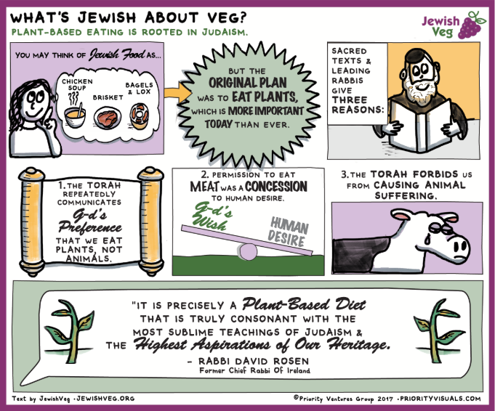

Slide 30

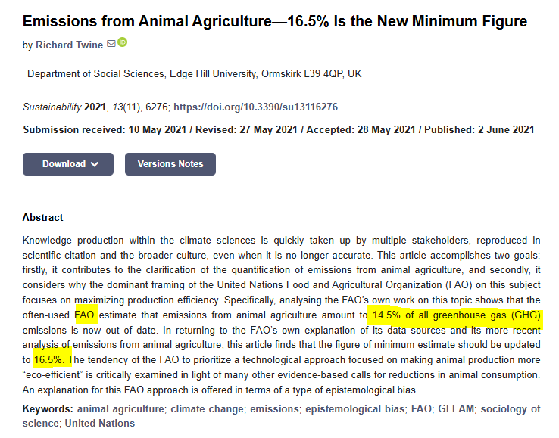
Prohibition of causing needless cruelty to animals (tza’ar ba’alei chayim)
Avoid the waste of natural ressources (bal tschchit)
“The Lord God took the man and put him in the Garden of Eden to work it and take care of it.” (Genesis 2:15 )
2020
“For all these reasons, the honest conclusion must be that it is virtually impossible today to live in accordance with Jewish religious requirements if one is party to the consumption of animal products, especially in Western society; and that a contemporary dietary lifestyle that is consistent with kashrut in practice and in spirit must be a plant-based diet.”

Slide 31
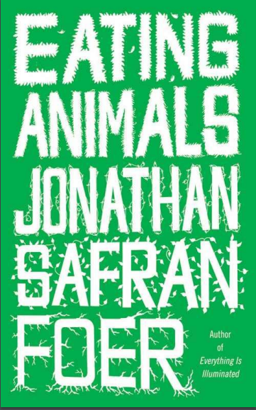
KOSHER?
As I was taught them, in Hebrew school and at home, the Jewish dietary laws were devised as a
compromise: if humans absolutely must eat animals, we should do so humanely, with respect for the other creatures in the world and with humility. Don’t subject the animals you eat to unnecessary suffering, either in their lives or in their slaughter. It’s a way of thinking that made me proud to be Jewish as a child, and that continues to make me proud.
This is why when fully conscious cattle at the (then) largest kosher slaughterhouse in the
world, Agriprocessors in Postville, Iowa, were videotaped having their tracheas and esophagi
systematically pulled from their cut throats, languishing for up to three minutes as a result of
sloppy slaughter, and being shocked with electric prods in their faces, it bothered me even more than the innumerable times I’d heard of such things happening at conventional slaughterhouses.
2009

Slide 32
The president of the Rabbinical Assembly of the Conservative Movement, in a message sent to every one of its rabbis, asserted, “When a company purporting to be kosher violates the prohibition against tza’ar ba’alei hayyim, causing pain to one of God’s living creatures, that company must answer to the Jewish community, and ultimately, to God.” The Orthodox chair of the Talmud Department at Israel’s Bar Ilan University also protested, and did so eloquently: “It very well may be that any plant performing such types of [kosher slaughter] is guilty of hillul hashem — the desecration of God’s name — for to insist that God cares only about his ritual law and not about his moral law is to desecrate His Name.” And in a joint statement, more than fifty influential rabbis, including the president of the Reform Central Conference of American Rabbis and the dean of the Conservative movement’s Ziegler School of Rabbinic Studies, argued that “Judaism’s powerful tradition of teaching compassion for animals has been violated by these systematic abuses and needs to be reasserted.”
This raises a difficult question, which I ask not as a thought experiment but
straightforwardly: In our world — not the shepherd-and-flock world of the Bible, but our overpopulated one in which animals are treated legally and socially as commodities — is it even possible to eat meat without “causing pain to one of God’s living creatures,” to avoid (even after going to great and sincere lengths) “the desecration of God’s name”? Has the very concept of kosher meat become a contradiction in terms?

Slide 33


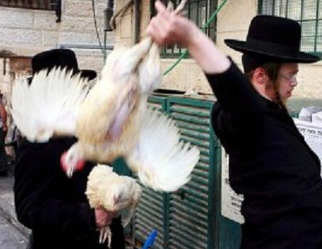
(religious university)
2019: Animals, slaves and robots: a discourse of rights and obligations in law, philosophy, and halakhah
Kapparot ☹
(atonement ritual on the eve of Yom Kippur)
Political party: Tsedek Lakol (Justice for All)

Slide 34
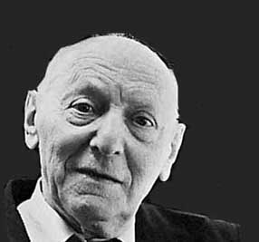
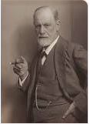
☞ Jewishness > Judaism
“When a human kills an animal for food, he is neglecting his own hunger for justice. Man prays for mercy, but is unwilling to extend it to others. Why should man then expect mercy from God? It's unfair to expect something that you are not willing to give. It is inconsistent. I can never accept inconsistency or injustice. Even if it comes from God. If there would come a voice from God saying, ‘I'm against vegetarianism!’ I would say, ‘Well, I am for it!’ This is how strongly I feel in this regard.” (preface to Steven Rosen’s Food for Spirit: Vegetarianism and the World Religions, 1986)
Isaac Bashevis Singer (1902–1991)
This is my protest against the conduct of the world. To be a vegetarian is to disagree — to disagree with the course of things today. Nuclear power, starvation, cruelty — we must make a statement against these things. Vegetarianism is my statement. And I think it's a strong one.
Solidarity as an ontological dimension of Jewishness
“[A]s a Jew I was prepared to join the opposition and to do without agreement with the ‘compact majority’” (1926, address to the Society of B'nai B'rith)

Slide 35

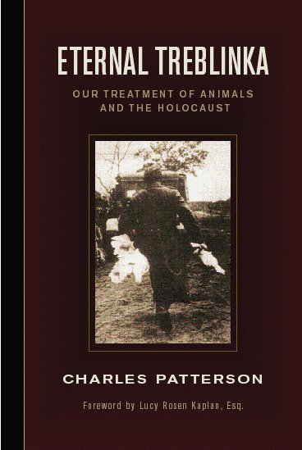
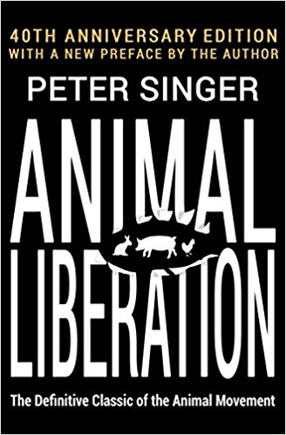
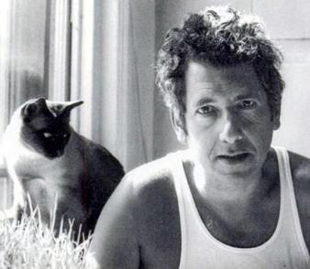
“I did not become a vegetarian for my health, I did it for the health of the chickens.”
The Letter Writer
“In his thoughts, Herman spoke a eulogy for the mouse who had shared a portion of her life with him and who, because of him, had left this earth. ‘What do they know - all these scholars, all these philosophers, all the leaders of the world - about such as you? They have convinced themselves that man, the worst transgressor of all the species, is the crown of creation. All other creatures were created merely to provide him with food, pelts, to be tormented, exterminated. In relation to them, all people are Nazis; for the animals it is an eternal Treblinka’.”
Peter Singer (born 1946)
“My perspective and mindset were certainly shaped by the fact that I
was Jewish, but not in a conscious way. In the
animal liberation movement, I found many people with Jewish background.” (June 2016)
Henry Spira (1927-1998, Hashomer Hatzair)

Slide 36





IV – Trend, social movement… and parallel dehumanization
vegannation.io

Slide 37


May 7, 2015
Ayelet Shaked, to be the next justice minister posted in July 2014, regarding Palestinians:
“ They are all enemy combatants, and their blood shall be on all their heads. Now this also includes the mothers of the martyrs, who send them to hell with flowers and kisses. They should follow their sons, nothing would be more just. They should go, as should the physical homes in which they raised the snakes. Otherwise, more little snakes will be raised there.”

Slide 38



February 09, 2016

Slide 39

On October 9, 2023, Israeli Defense Minister Yoav Gallant declared “We are imposing a complete siege on Gaza. No electricity, no food, no water, no fuel. Everything is closed. We are fighting human animals, and we will act accordingly.”
He was describing Hamas militants following their large-scale, surprise attack on Israel two days prior.
The remark was subsequently cited by legal scholars and in South Africa's submission to the International Court of Justice as part of the evidence used to argue that Israeli officials employed language indicative of genocidal intent.

Slide 40





Being Jewish means being vegan
(Tikkun olam, “repair of the world”)
About her great-grandfather: “He was a moral vegetarian. He thought that the brutality that humans carried out against each other had its roots in the brutality that they carried out against animals.”
+ “Cousin Jack Lush” was a militant vegetarian long before the diet became mainstream
2019
1938

